Slide 1

Consumer Habits and Their Environmental Impact
Konstanty Lamcha, Cyryl Drążkowski

Slide 2
The Culture of Consumption in the 21st Century
We live in an era of hyper-consumption.
Consumption is not only economic — it’s cultural
"You are what you buy."
Brands and influencers promote excess as freedom and identity.
Everyday products are marketed as “solutions” to emotional needs.
Companies create artificial demand and shorten product lifespans.

Slide 3
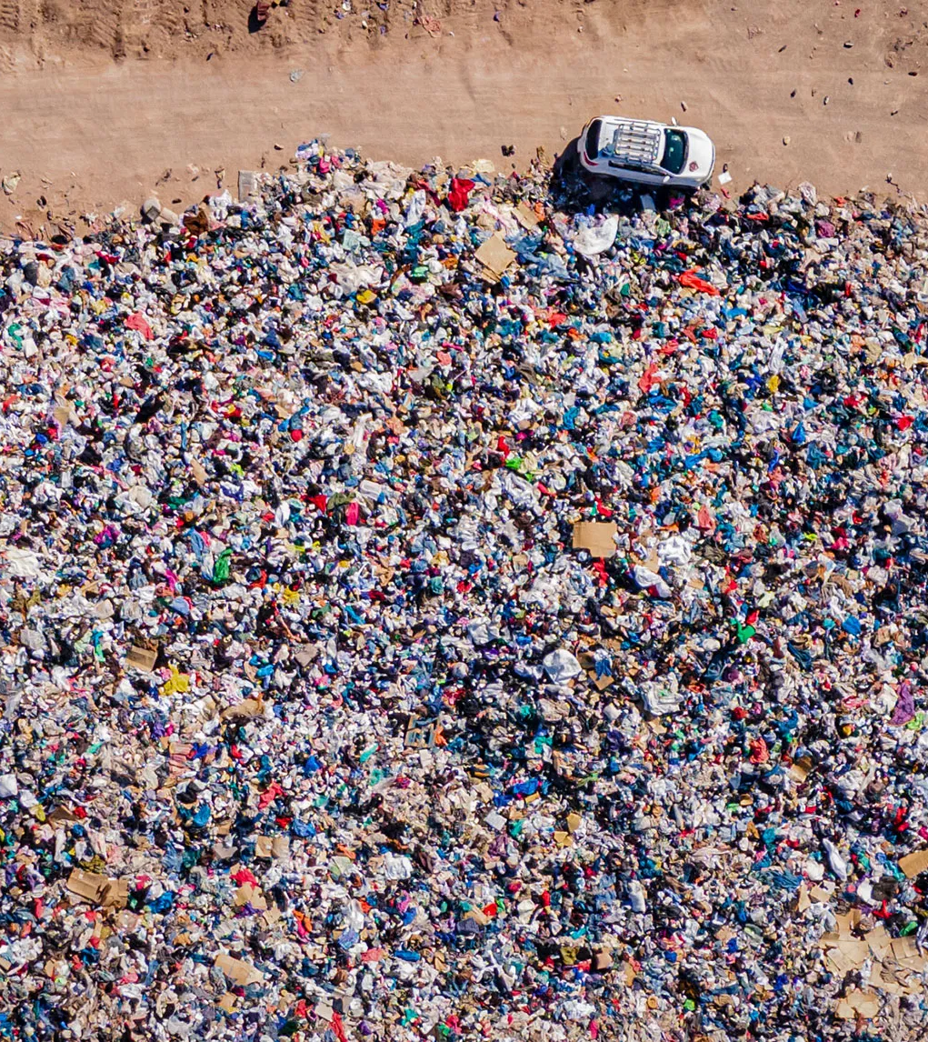
Fast Fashion – Cheap Clothes, High Emissions
Contributes 8–10% of global CO₂ emissions.
Consumes vast amounts of water and uses toxic chemicals.
60% of fabrics are plastic-based — made from fossil fuels.
Over 90 million tons of textile waste annually.

Slide 4
Greenwashing – The Myth of Sustainable Consumption
Many companies falsely market products as “green,” “eco,” or “carbon-neutral.”
Greenwashing is the practice of appearing environmentally friendly while continuing harmful practices.
Oil companies promoting renewable energy while expanding drilling.
Fashion brands like H&M or Zara offering “conscious collections” made from synthetic materials.
Consumers are told “you can shop your way to sustainability” — but this is a myth.

Slide 5
The Carbon Footprint Trap – How BP Shifted the Blame
In 2004, British Petroleum launched a global “carbon footprint” campaign.
01
It introduced online tools to calculate your personal emissions.
02
The strategy made climate change feel like a personal lifestyle problem, not a political or industrial one.
03
BP continued oil expansion while suggesting you turn off your lights.
04

Slide 6

Who Is Truly Responsible?
UNEP Emissions Gap Report 2020:
The wealthiest 1% emit more than twice as much as the poorest 50%.
G20 nations account for 78% of global emissions.
Systemic issues:
Corporate lobbying, fossil fuel subsidies, tax avoidance.
Policies made by and for elites.

Slide 7
What Needs to Change
Support regulation
Vote with your wallet and ballot
Organize and pressure institutions
Shift narratives

